Slide 1

Prof. Kasun Samarasinghe
EAI 6000​ Final Project Report
By
Dhiren Pagrani
Sunil Raj Thota
Shivani Sharma

Slide 2
INTRODUCTION
This project is based on the medical research conducted by MIT and Harvard which is serving the purpose of developing a drug advancement through enhancements to “Mechanisms of Action (MoA)” prediction algorithms.
As the discovery of new drugs has evolved, the technology of innovation has also improvised. As of now, researchers look to recognize a protein target related to disease and build up a molecule that can regulate that protein target. As a shorthand to depict the biological movement of a given molecule, scientists allot a mark alluded to as Mechanism of Action or MoA for short.

Slide 3
BUSINESS PROBLEM
Our goal is to improvise the algorithm already implemented by MIT and Harvard which provides the classification of drugs based on the biological activities happening as a result of medicines with the body cells and predict molecular targets from that data using an integrated preprocessing and machine learning pipeline.
We have decided a approach with this dataset that joins quality articulation and cell feasibility information.
The information depends on another innovation that measures at the same time (inside similar examples) human cells' reactions to drugs in a pool of 100 diverse cell types

Slide 4


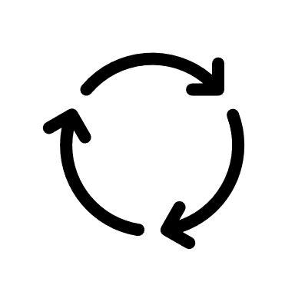

EXPLORATORY DATA ANALYSIS
Explored to uncover patterns, characteristics, and points of interest
Its a combination of data visualizations, charts, and initial reports
To get a broad picture of important trends and major points
Data Exploration
The data can have many irrelevant and missing parts
To handle this part, data cleaning is done
It involves handling of missing data, noisy data etc.
Data Cleaning
Data preprocessing is a data mining technique
Used to transform the raw data in a useful and efficient format
Data Preprocessing
It is a process of inspecting, cleansing, transforming and modelling data
To discover useful information, conclusions and supporting decision-making
Data Analysis

Slide 5
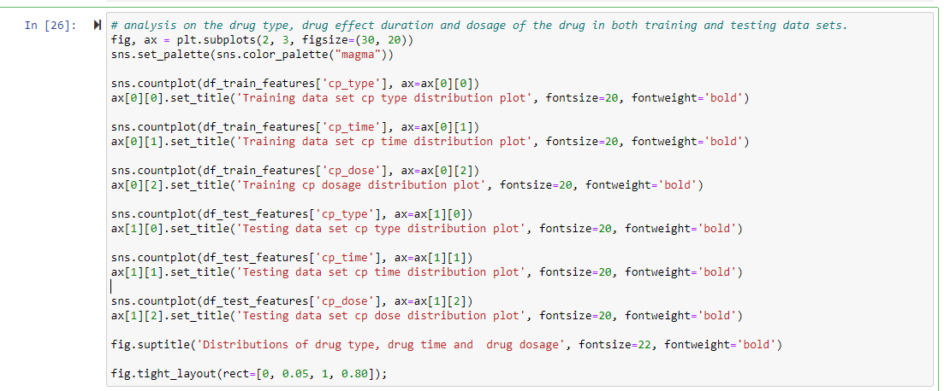
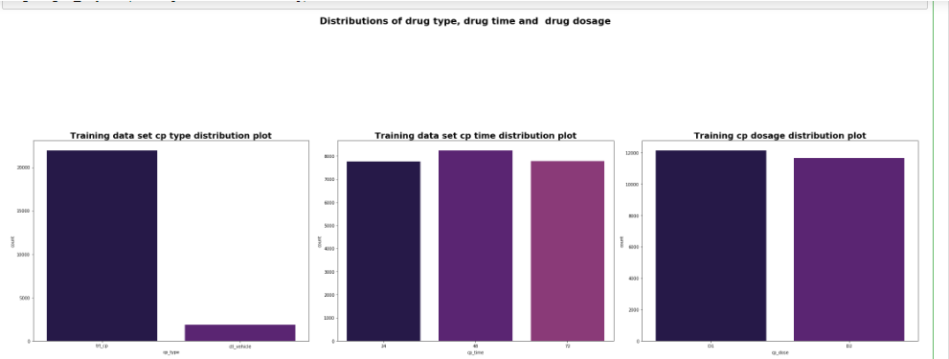
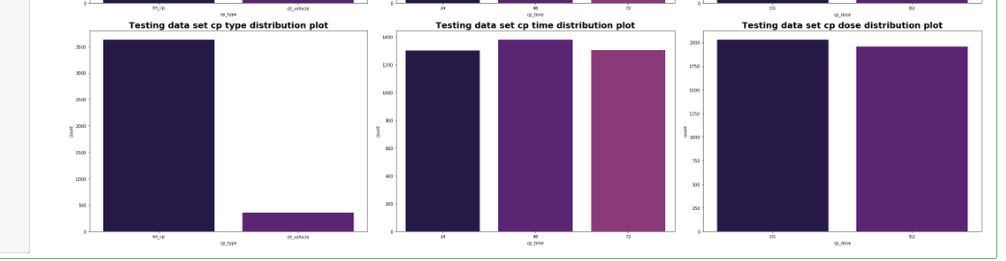
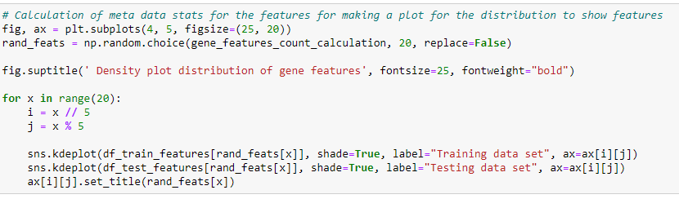
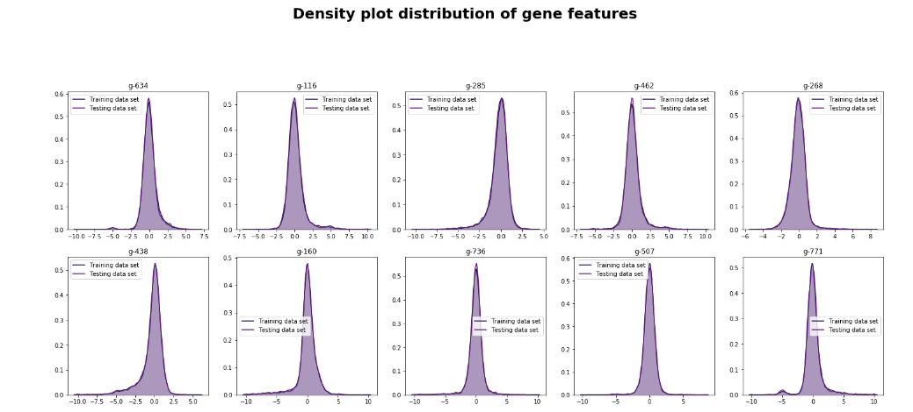
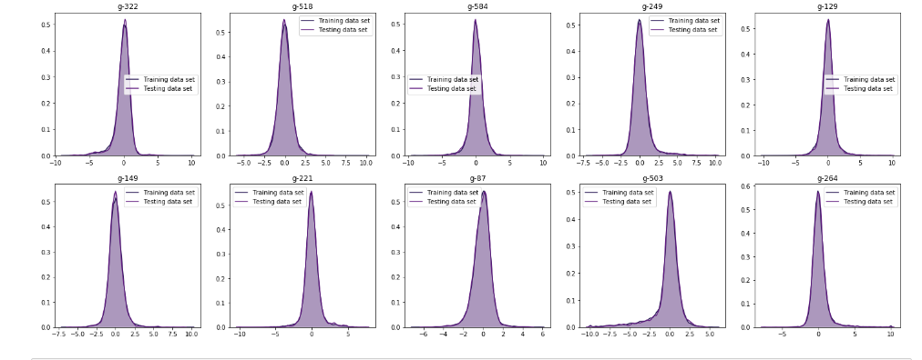

Slide 6
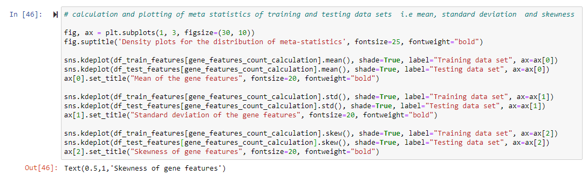
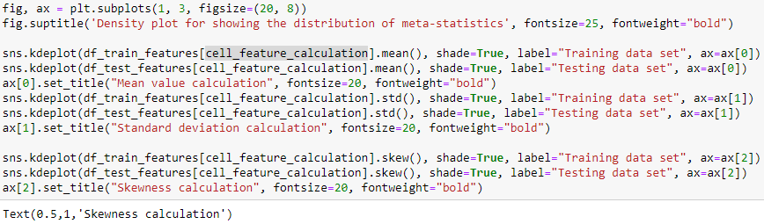
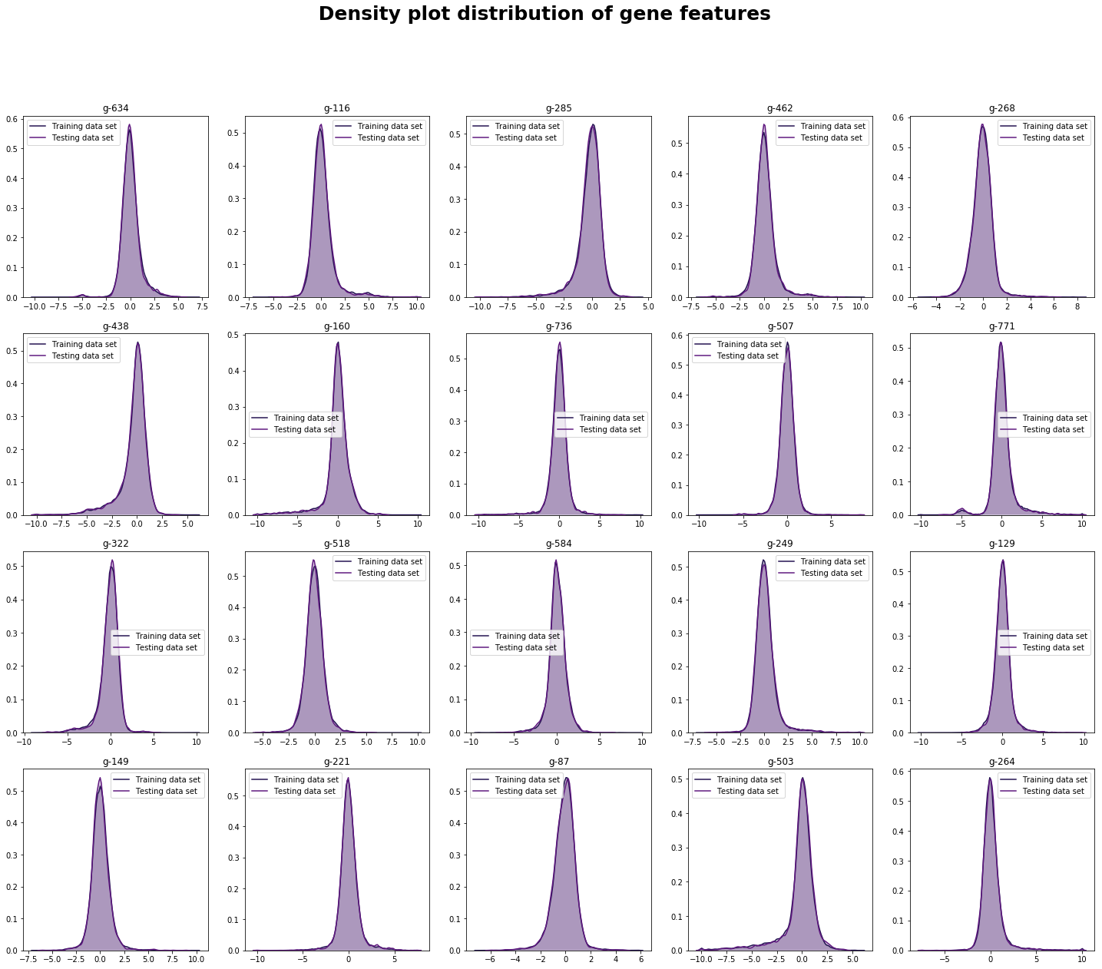
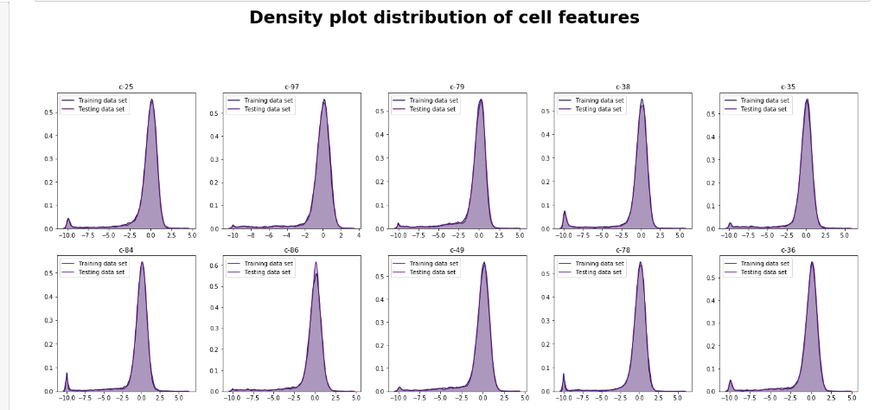
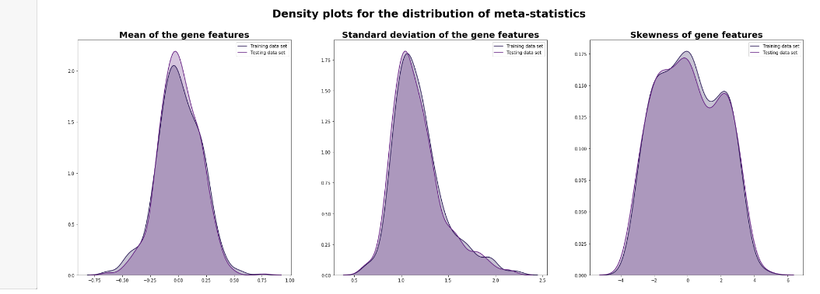
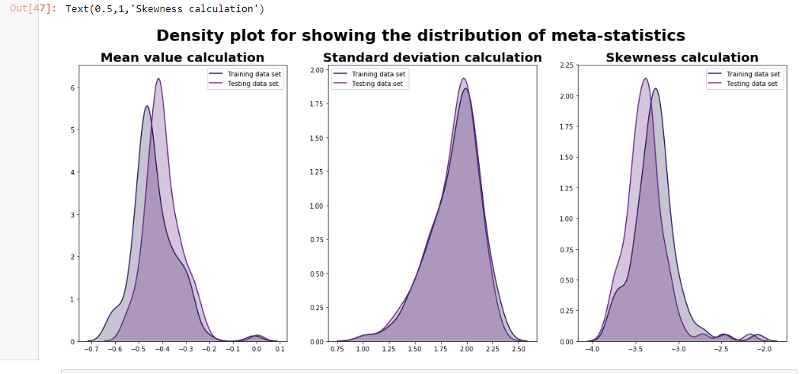

Slide 7
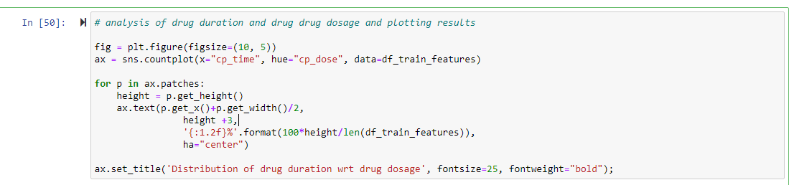
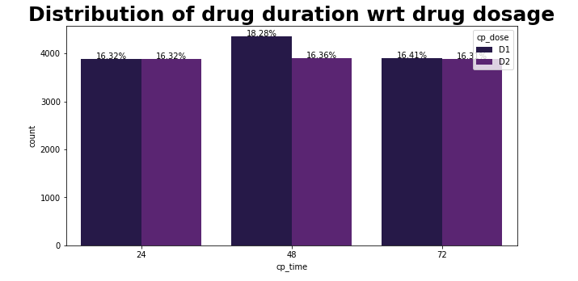
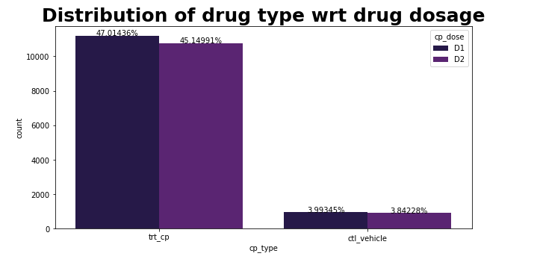
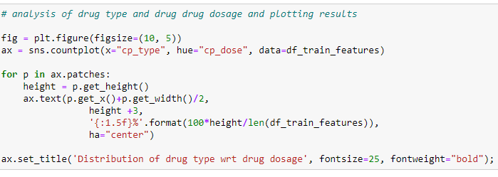
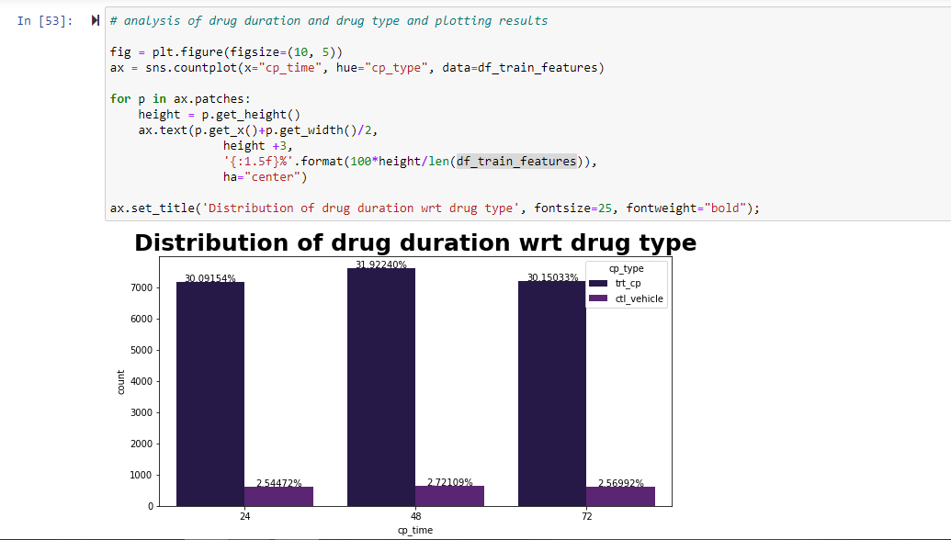

Slide 8
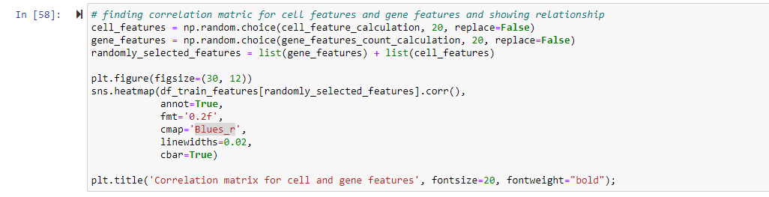
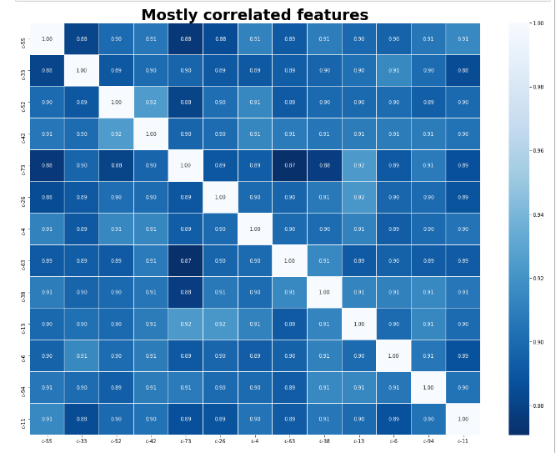
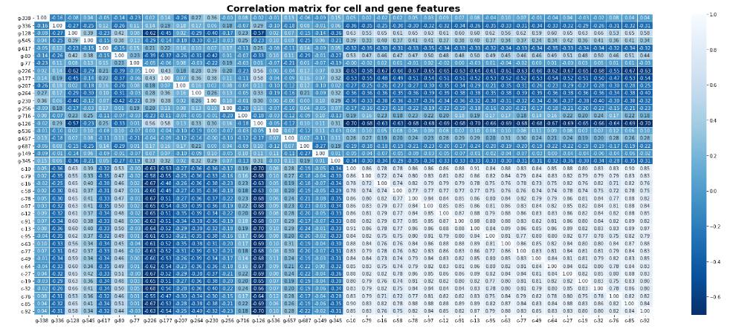
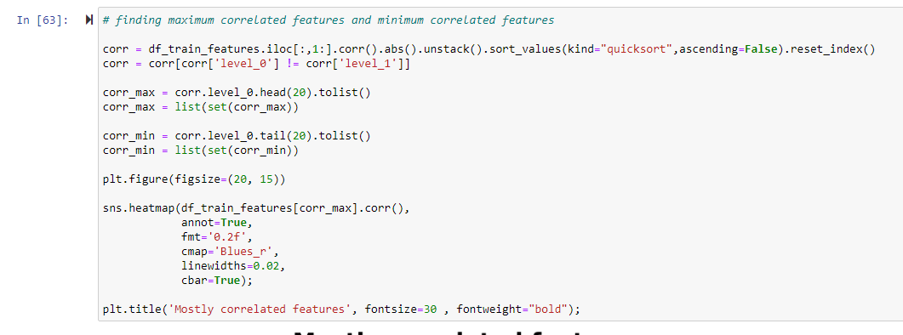

Slide 9
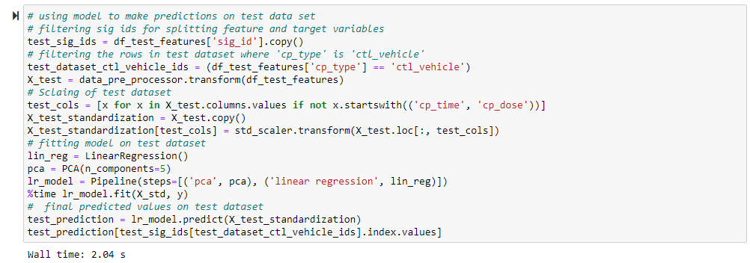
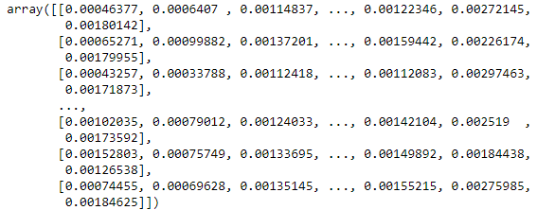
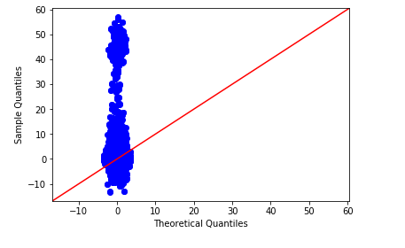
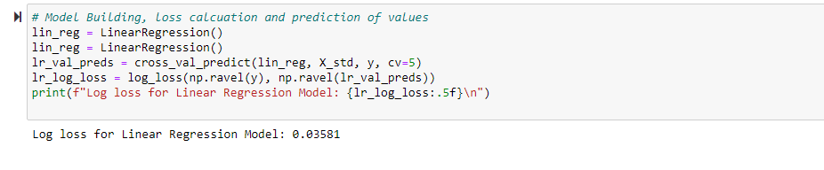
LINEAR REGRESSION MODEL
It is a continuous model used
Predicts the value of a variable based on the value of another variable
One variable is considered to be an explanatory variable, and the other is considered to be a dependent variable

Slide 10
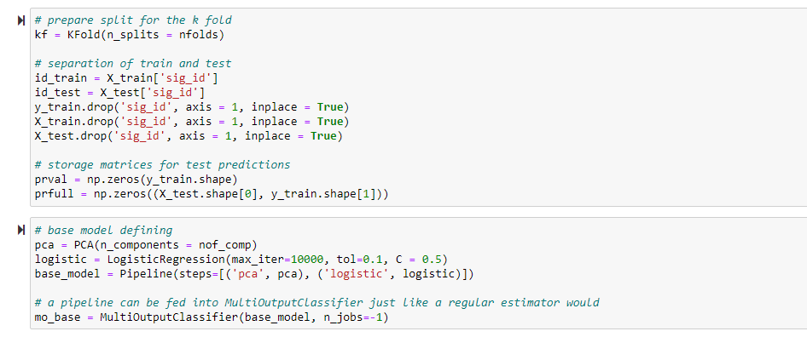
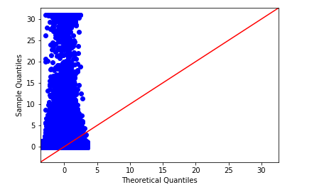
LOGISTIC REGRESSION MODEL
Logistic is an appropriate regression analysis to perform when the dependent variable is dichotomous or binary
It is used to to make classifications into various categories like 1/ 0, Yes/ No, True/ False or Failure/ Success, etc.
It predicts the probability of occurrence of an incident by fitting data to a logit function

Slide 11
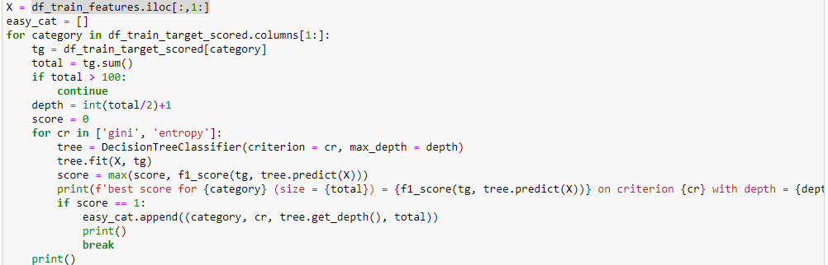
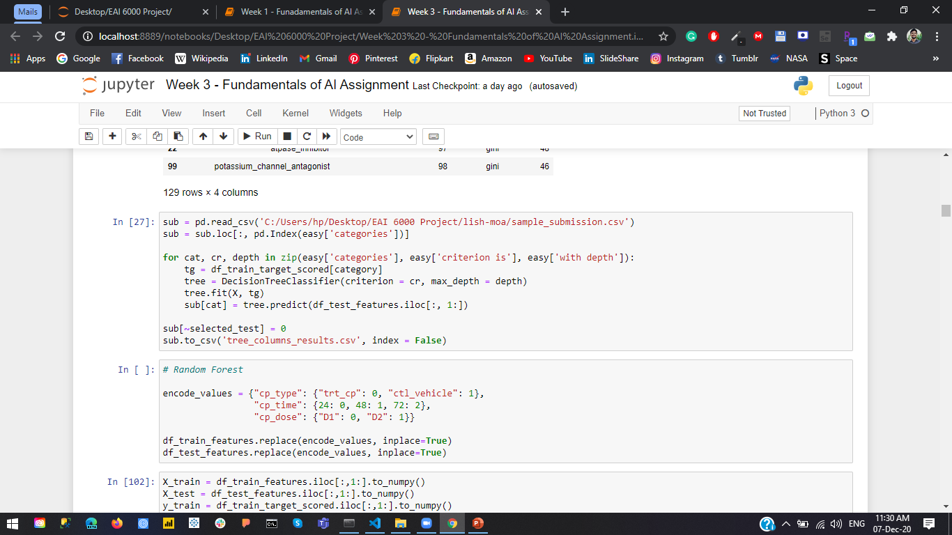
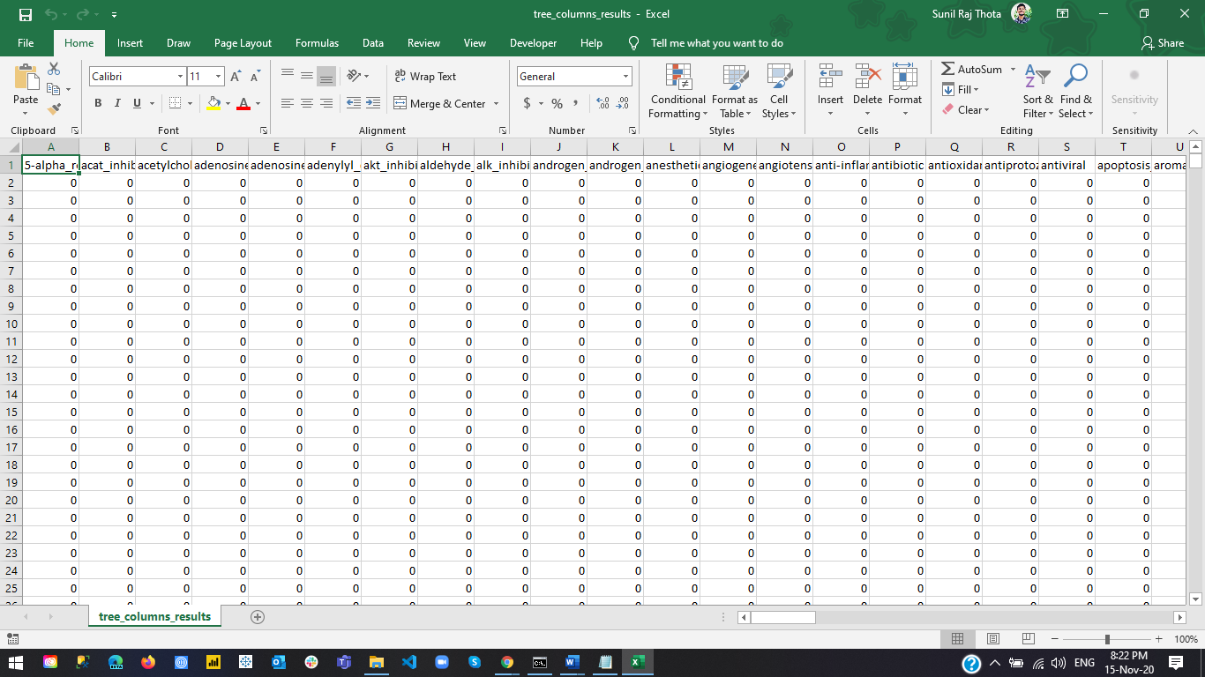
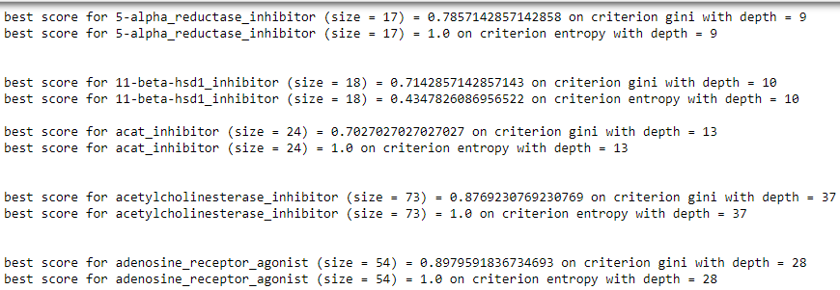
DECISION TREE MODEL
It classifies a way to split a data set based on various conditions
One of the most widely used model in supervised learning
Used for both classification and regression tasks
Predicts the value of a target by learning simple decision rules
Rules are in form of if-then-else statements
Deeper the tree, the more complex the rules and fitter the model

Slide 12
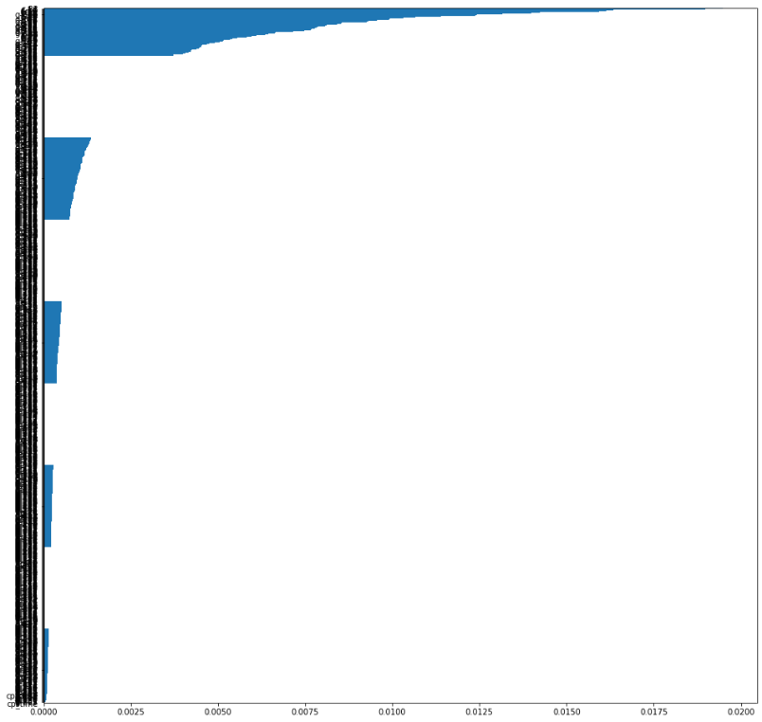
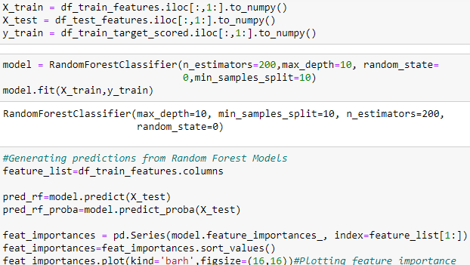
RANDOM FOREST MODEL
Tree-based algorithm that leverages the facility of multiple decision trees for creating decisions
Each node within the decision tree works on a random subset of features to calculate the output
The random forest then combines the output of individual decision trees to get the ultimate output
This process of mixing the output of multiple individual models is called as Ensemble Learning

Slide 13
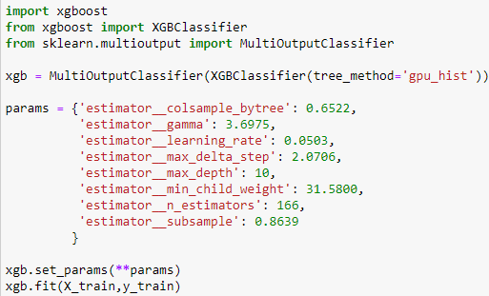
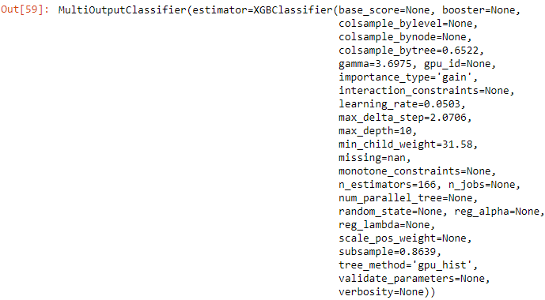
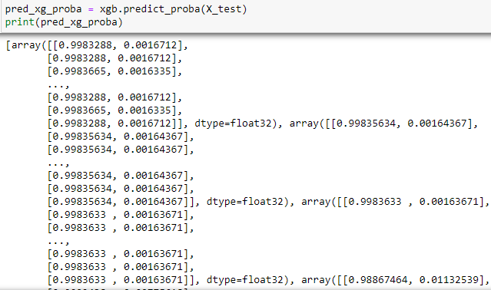
XG (EXTREME GRADIENT BOOSTING) BOOST MODEL
It is a scalable end-to-end tree boosting system used for implementation of gradient boosted decision trees
Designed for speed and performance with predictive power and is almost 10 times faster than the others
It deals with regularization techniques which reduces overfitting and improves overall performance
Automatically handles missing values, Built-in Cross Validation, and Tree Pruning are few benefits

Slide 14
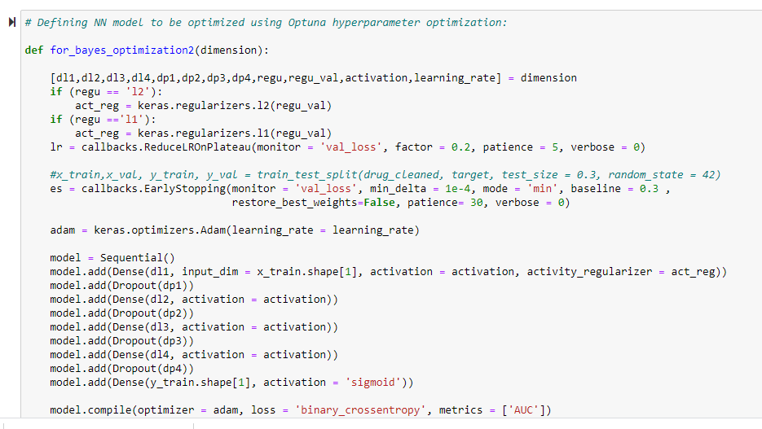
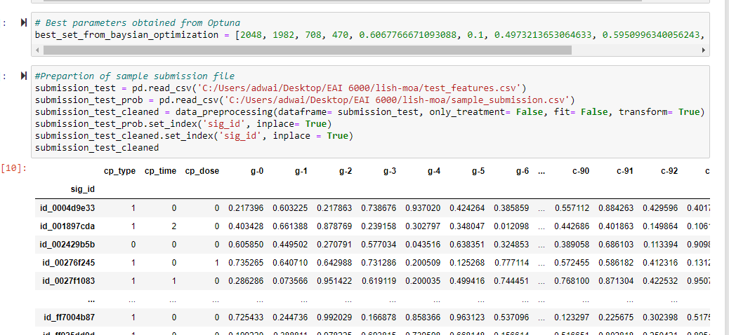
HYPER PARAMETER TUNING MODEL
General Parameters: Guide the overall functioning
Booster Parameters: Guide the individual booster (tree/regression) at each step
Learning Task Parameters: Guide the optimization performed

Slide 15
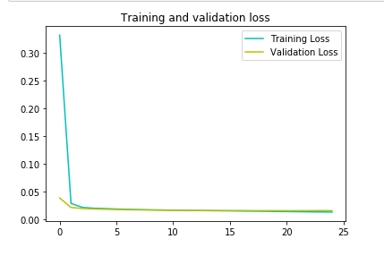
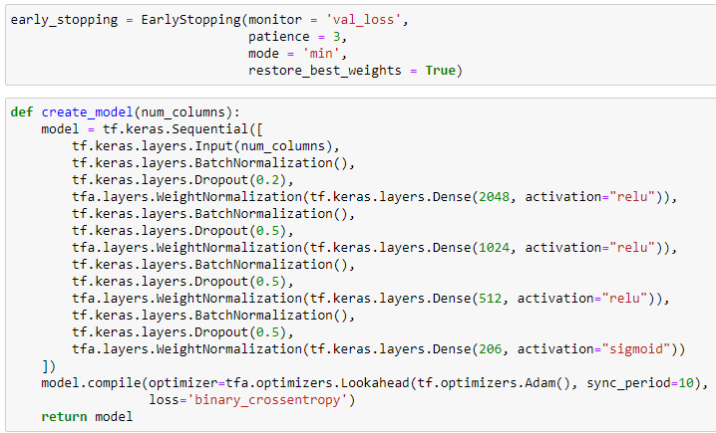
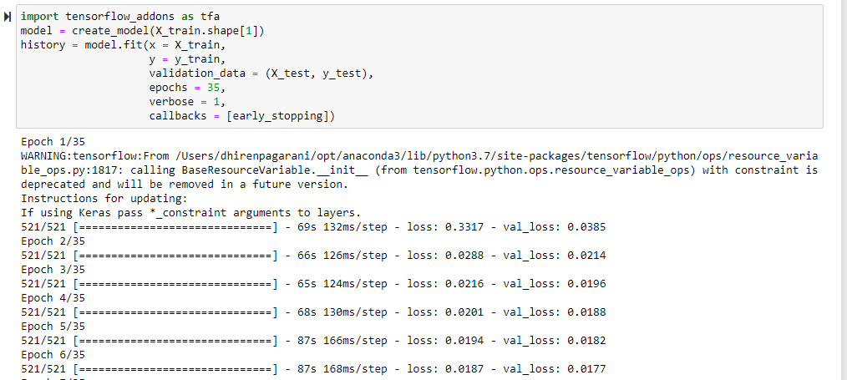
NEURAL NETWORKS
Neural networks are reducible to regression models - can "pretend" to be any sort of regression model
A basic NN with just one information neuron, one hidden neuron, and one output neuron, is identical to logistic regression
It takes several dependent factors = input boundaries, multiplies them by their coefficients = weights
The logistic regression we modeled is reasonable for binary classification

Slide 16
COMPARISON OF MODELS
MODEL | LOG LOSS | ACCURACY (%)
LINEAR REGRESSION | 0.035 | 65.42
LOGISTIC REGRESSION | 0.029 | 69.73
DECISION TREE | 0.028 | 71.42
RANDOM FORESTS | 0.021 | 73.12
XG BOOST | 0.016 | 76.38
NEURAL NETWORKS | 0.015 | 79.54

Slide 17
CONCLUSION
We have successfully improvised the existing algorithm and implemented XG Boost and Neural Network with more than 78% accuracy.
Through this form of data analysis, we can get models which can highlight important data classes and even models that can tell us about the future trends
We figured out the most significant features with the correlation and relationships among them. To further extend, we used random forest which will help us to feed test data to all the decision trees
The points that were incorrectly placed on the wrong side of decision boundary were penalized using the penalty parameter. All these methods help us to understand our data in a more effective way

Slide 18
REFERENCES
Real Python. “Linear Regression in Python.” Real Python, Real Python, 7 Nov. 2020, realpython.com/linear-regression-in-python/
Jaadi, Z. (n.d.). A Step by Step Explanation of Principal Component Analysis. Retrieved November 09, 2020, from https://builtin.com/data-science/step-step-explanation-principal-component-analysis
Varshney, P. (2020, October 17). Q-Q Plots Explained. Retrieved November 09, 2020, from https://towardsdatascience.com/q-q-plots-explained-5aa8495426c0
Model-Building Strategies and Methods for Logistic Regression. (2005). Applied Logistic Regression, 91-142. doi:10.1002/0471722146.ch4
Dawson, C. (2019, September 26). Gradient Boosting in Python from Scratch. Retrieved October 06, 2020, from https://towardsdatascience.com/gradient-boosting-in-python-from-scratch-4a3d9077367
Megha Mishra (May 26, 2018), REGULARIZATION: An important concept in Machine Learning, https://towardsdatascience.com/regularization-an-important-concept-in-machine-learning-5891628907ea

Slide 19
THANK YOU

